Slide 1
Endpoint Protection
System Management User Group
Jon Warnken

Slide 2
Endpoint Protection
Antimalware
Windows Defender Firewall
Windows Defender ATP Polices
Windows Defender Exploit Guard
Windows Defender Application Guard
Notes:
https://docs.microsoft.com/en-us/sccm/protect/deploy-use/endpoint-protection
https://docs.microsoft.com/en-us/sccm/protect/deploy-use/endpoint-antimalware-policies
https://docs.microsoft.com/en-us/sccm/protect/deploy-use/create-windows-firewall-policies
https://docs.microsoft.com/en-us/sccm/protect/deploy-use/windows-defender-advanced-threat-protection
https://docs.microsoft.com/en-us/windows/security/threat-protection/windows-defender-exploit-guard/windows-defender-exploit-guard
https://docs.microsoft.com/en-us/windows/security/threat-protection/windows-defender-application-guard/wd-app-guard-overview

Slide 3
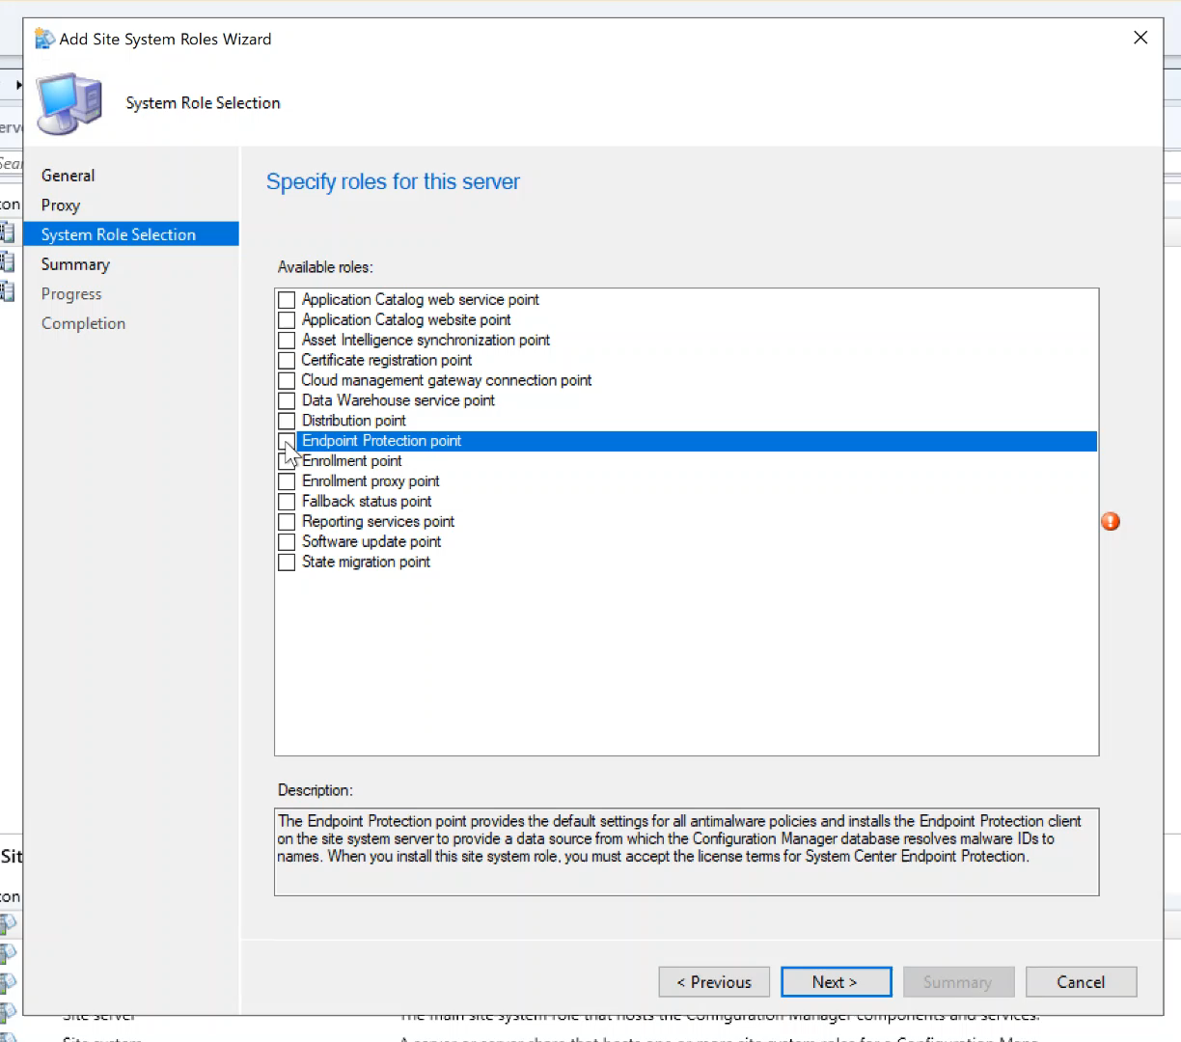

Slide 4
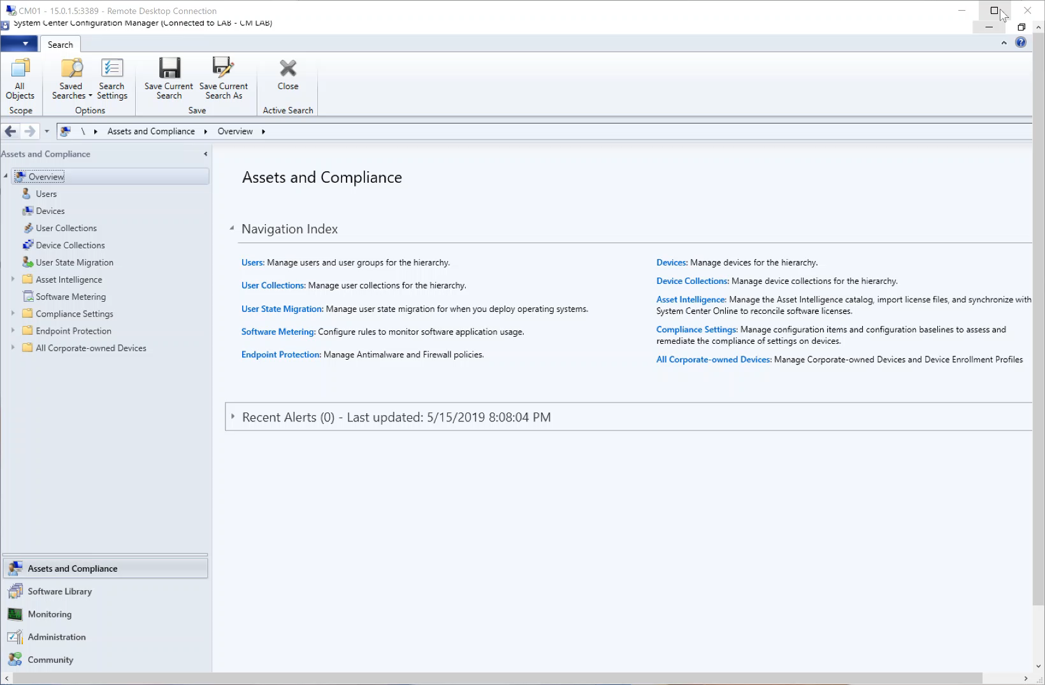

Slide 5
Testing your configuration
Potentially Unwanted Applications
https://www.amtso.org/feature-settings-check-potentially-unwanted-applications/
Cloud Protection (Smart Screen)
https://aka.ms/ioavtest
Antimalware
Create a file with the text - X5O!P%@AP[4\PZX54(P^)7CC)7}$EICAR-STANDARD-ANTIVIRUS-TEST-FILE!$H+H*
Change to a executable extension to test i.e. test,bat
http://2016.eicar.org/86-0-Intended-use.html

Slide 6
SQL Queries for at risk systems
-- Systems at risk
select SMS_R_SYSTEM.ResourceID,SMS_R_SYSTEM.ResourceType,SMS_R_SYSTEM.Name,SMS_R_SYSTEM.SMSUniqueIdentifier,SMS_R_SYSTEM.ResourceDomainORWorkgroup,SMS_R_SYSTEM.Client
from SMS_R_System
inner join SMS_G_System_EndpointProtectionStatus on SMS_G_System_EndpointProtectionStatus.ResourceID = SMS_R_System.ResourceId
where SMS_G_System_EndpointProtectionStatus.AtRisk = 1
-- Older than 7 days
select SMS_R_SYSTEM.ResourceID,SMS_R_SYSTEM.ResourceType,SMS_R_SYSTEM.Name,SMS_R_SYSTEM.SMSUniqueIdentifier,SMS_R_SYSTEM.ResourceDomainORWorkgroup,SMS_R_SYSTEM.Client
from SMS_R_System
inner join SMS_G_System_EndpointProtectionStatus on SMS_G_System_EndpointProtectionStatus.ResourceID = SMS_R_System.ResourceId
where SMS_G_System_EndpointProtectionStatus.SignatureOlderThan7Days = 1

Slide 7
Logs Logs Logs
Endpoint Protection Log File | Description | Log File Location
EPCtrlMgr.log | Records details about the synchronization of malware threat information from the Endpoint Protection role server into the Configuration Manager database. | Site system server hosting the role. C:\Program Files\Microsoft Configuration Manager\Logs
EPMgr.log | Records the status of Endpoint Protection site | Site system server hosting the role. C:\Program Files\Microsoft Configuration Manager\Logs
EPSetup.log | Provides information about the installation of the Endpoint Protection site system role. | Site system server hosting the role. C:\Program Files\Microsoft Configuration Manager\Logs
EndpointProtectionAgent.log | Records details about the installation of the Endpoint Protection client and the application of anti-malware policy to that client. | Located on client machine. C:\Windows\CCM\Logs
MPLog-XX.log | Records Endpoint Protection activity on the client side. | Located on client machine. C:\ProgramData\Microsoft\Windows Defender\Support
MPDetection-XX.log | Records details about each case of malware detected on the system. | Located on client machine. C:\ProgramData\Microsoft\Windows Defender\Support
NisLog.txt | Records details about the Network Inspection System. | Located on client machine. C:\ProgramData\Microsoft\Windows Defender\Network Inspection System\Support

Slide 8
Troubleshooting
Command line
%ProgramFiles%\Windows Defender\MpCmdRun.exe
https://docs.microsoft.com/en-us/windows/security/threat-protection/windows-defender-antivirus/command-line-arguments-windows-defender-antivirus

